Slide 1
Chemometrics - formulas and tests, 2nd part
Simple linear regression 2
Univariate linear regression of m-th order 7
Multiple linear regression 9
Validation of regression models 11
Residuals and leverage values; Williams plot 12
Experimental design: empirical models (k factors) 13
Full factorial designs (2^{k}) 14
Mixture design and application of DoE to chromatography 15
Principal Components Analysis 16
Inverse calibration, Principal Component Regression and Partial Least Squares 18
Cluster Analysis 19
Classification methods 21
Quality control and sampling 24

Slide 2
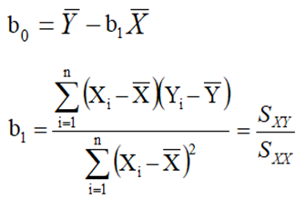
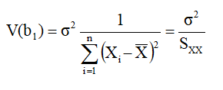
Simple linear regression
Model
Main assumptions
Y_{i} ∼
for i = 1,2,…. ,n;
for i ≠ j = 1,2,….,n.
Regression equation and coefficients

Slide 3
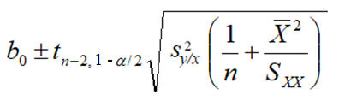
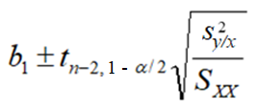
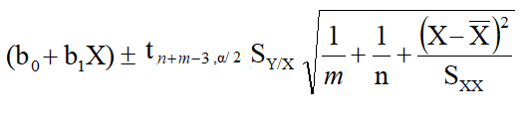
Confidence intervals for coefficients
Confidence intervals for Y values
Note: s_{y/x} (or S_{Y/X})is used as the best estimator for σ
Coefficient of determination (R²) and correlation coefficient (ρ²_{XY})
Prediction intervals for Y
one replicate
m replicates

Slide 4
ANOVA for simple linear regression (without lack of fit estimation)
SS_{TOT} = SS_{REG} + SS_{RES}
Source of variation | SS | df | MS | E(MS)
Regression |  | 1 | MS_{REG}
Residuals |  | n-2 | MS_{RES} | σ ²
Total |  | n-1
Criterion for significance of regression

Slide 5
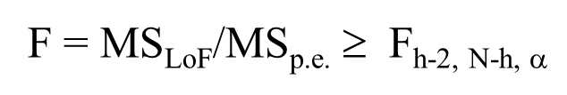
ANOVA for simple linear regression (with lack of fit estimation)
Source of variation | SS | df | MS | E(MS)
Total |  | N-1
Regression | By subtraction | 1 | MS_{REG}
Residuals |  | N-2 | MS_{RES} | σ²
Lack of Fit | By subtraction | h-2 | MS_{LoF}
Pure error |  | N-h | MS_{p.e.}
Criterion for lack of fit assessment
5

Slide 6
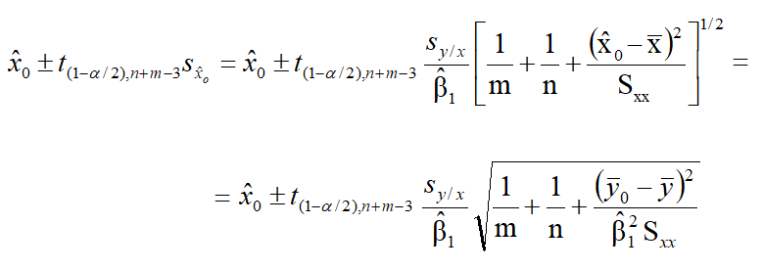
Calibration and inverse regression
x₀ estimates
one replicate
m replicates
Confidence interval for x₀: Wald interval (m replicates)

Slide 7


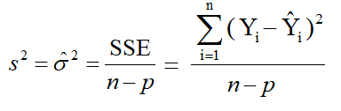
Univariate linear regression of order m
Model
Matricial equations for responses and coefficients
(n×1) (n×p) (p×1) (n×1)
(p×1) (p×p) (p×1)
Expectation and variance of vector b; unbiased estimator for σ²
p = m + 1

Slide 8

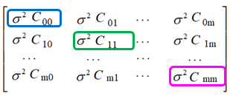

Variance of a specific coefficient b_{i}
Note: C_{ii} is the i-th element on the main diagonal of matrix
Confidence interval for b_{i} at a α significance level
Confidence interval for ŷ₀ at a α significance level

Slide 9




Multiple linear regression
Model
Matricial equations for responses and coefficients
Variance of vector b, unbiased estimator for σ²
Confidence interval for b_{j} at a α significance level
where C_{jj} is the j-th element on the main diagonal of matrix

Slide 10
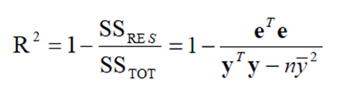
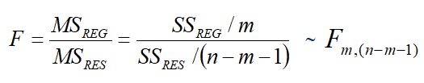

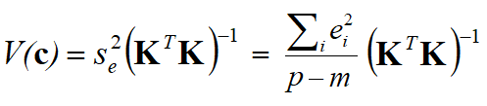
Coefficient of determination in multiple linear regression
Statistic for the evaluation of the significance of the model
Application of multiple linear regression to multicomponent analysis

Slide 11
Validation of regression models
Adjusted-R²
Predictive Error Sum of Squares (PRESS)
= value predicted for the i-th sample using a model in which the sample has not been taken into account
Coefficient of determination for cross validation

Slide 12
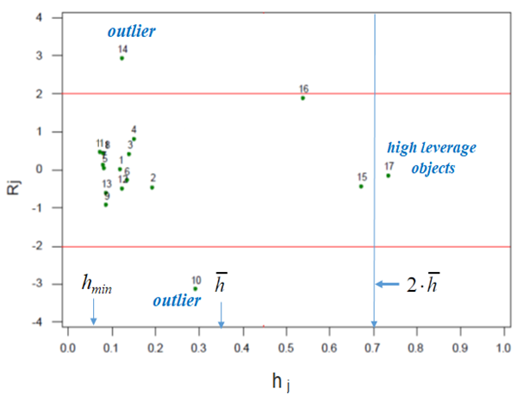
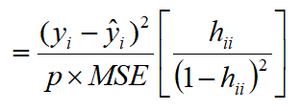
Residuals and leverage values; Williams plot
e = (I −H)y
Var(e) = (I − H)σ²
H = X(X^{T}X)⁻¹X^{T}
Residuals
where:
Leverages = diagonal elements of the H matrix (h_{ii}):
for simple linear regression
Internally studentized residuals
Williams Plot: standardized residuals vs leverages
i = 1,2,…,n
Cook distance (recognition of influential points)
i=1,2,….,n

Slide 13
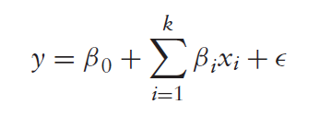
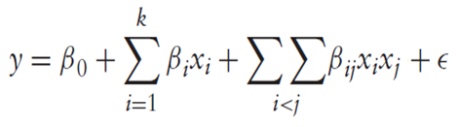
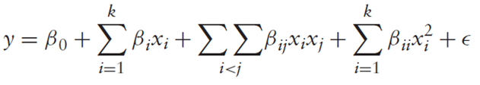
Experimental design: empirical models (k factors)
first-degree (linear) model
interaction model
second-degree (quadratic) model

Slide 14
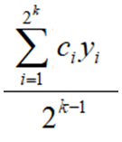
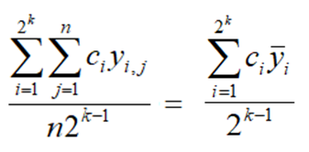
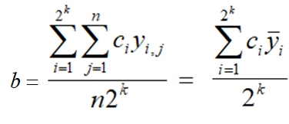
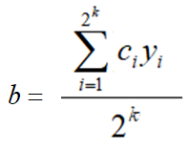
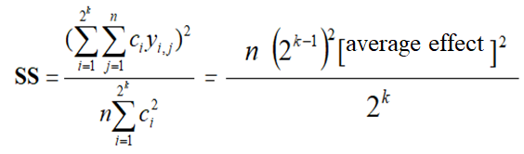
Full factorial designs (2^{k})
Average effects
without replicates
with n replicates
Model coefficients
without replicates
with n replicates
Sum of squares (n replicates)

Slide 15
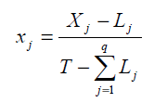





Mixture design and DoE applications to chromatography
Pseudo-components in mixture design
where:
Chromatographic Response Function (CRF)
R_{i} is the resolution between adjacent peak pairs
P is the number of peaks detected
t_{M} is the target retention time in minutes
t_{L} is the retention time for the last peak,
a and b are two arbitrary weighting factors
where:
Derringer’s desirability function (D)
where: or

Slide 16
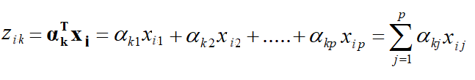


Principal Components Analysis
k-th principal component for i-th sample, described by p original variables
Variance of the k-th principal component
σ²₁ | cov (x₁,x₂) | … | … | cov (x₁,x_{p})
cov (x₂,x₁) | σ²₂ | . | . | .
. | . | . | . | .
. | . | . | . | .
cov (x_{p},x₁) | … | … | … | σ²_{p}
S =
Variance of the first principal component and constraint on its loadings

Slide 17

Obiective functions for the 1st and the 2nd principal components
L = α_{i}^{T}Sα_{i} - λ(α_{i}^{T}α_{i} - 1)
Matricial equations for scores (T) and loadings (P)
T = X P
S = P Λ P^{T}
Correlation between principal component z_{i} and original variable X_{j}

Slide 18


Inverse calibration, Principal Component Regression and Partial Least Squares
Regression model for inverse calibration in multi-component spectrophotometric analysis
Principal Component Regression: matricial equations
S_{X} (R_{X}) = P Λ P^{T}
T_{k} = X P_{k}
y = T_{k} α + ε
y = X β + ε
α = P_{k}^{T} β
β = P_{k} α
Partial Least Squares: matricial equations

Slide 19
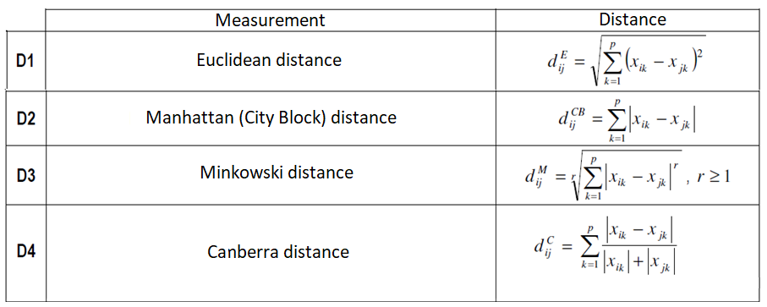
Cluster Analysis
Distance measurements (main approaches)
Similarity

Slide 20


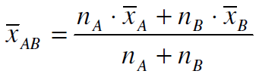


Clustering algorithms (main approaches)
single linkage
complete linkage
average linkage
centroid method
k-means method
within cluster sum of squares
total sum of squares

Slide 21
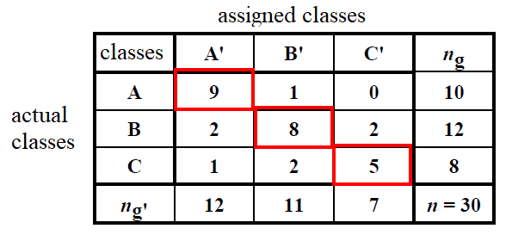
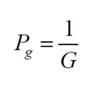
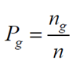



Classification methods
Confusion matrix (example with group NER% calculation) and related formulas
NER% (A) = 9/10 = 90.0%
NER% (B) = 8/12 = 66.7%
NER% (C) = 5/8 = 62.5%
NER%= [(9/10) + (8/12) + (5/8)]/3 x 100 = 73.05%
Non Error Rate
possible a priori probabilities
sensitivity of class g
specificity of class g

Slide 22
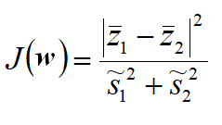
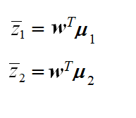

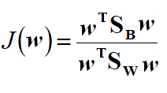




Linear Discriminant Analysis (two classes, k = 2)
z = X w
where:
w = (w₁, w₂, …, w_{p})^{T}
z_{i} = w^{T}x_{i} = w₁x_{i1} + w₂x_{i2} + … + w_{p}x_{ip}
where:
and
for i = 1, 2
Fisher linear discriminant
where:
and
Objective function (to be maximized)

Slide 23


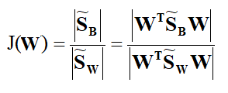




Linear Discriminant Analysis (more than 2 classes, k > 2)
where W is the projection matrix
where:
and
Fisher linear discriminant
Equation used to find W
Variable Importance in Projection (VIP) score for original variable j in Partial Least Squares – Discriminant Analysis (PLS – DA)
J and F = total numbers of original and latent variables, respectively
w²_{jf} = weight of variable j on the latent variable f
SSY_{f} = portion of y or Y variance explained by latent variable f
SSY_{tot.expl.} = variance explained by all latent variables.

Slide 24


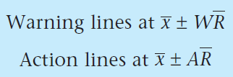

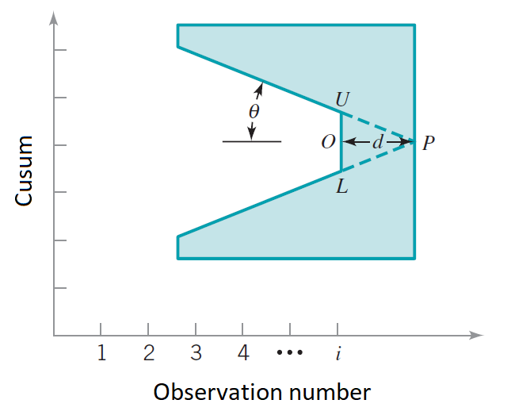
Quality control and sampling
Shewhart control chart for the mean
95% confidence lines
(warning lines)
99.7% confidence lines
(action lines)
Equations based on average range and W and A coefficients
Average Run Length for a system out of control (ARL_{Δ})
where β = probability that the chart does not indicate a deviation when the process is out of control
CUSUM control charts
tan θ = δ σ_{x} /2
alternative parameters
(Minitab 18):
k = tan θ = δ σ_{x} /2
d = (2/δ²) ln [(1-β)/α]
h = d tan θ = UO = OL

Slide 25
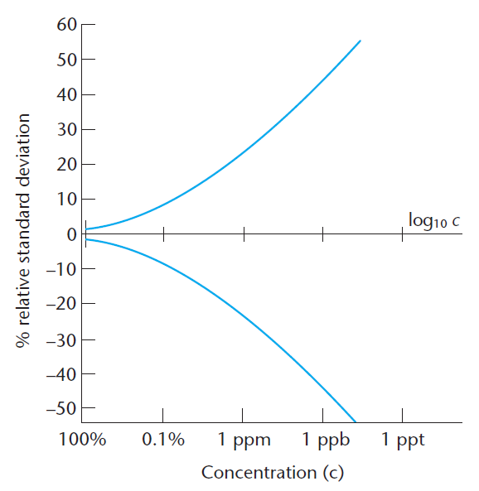



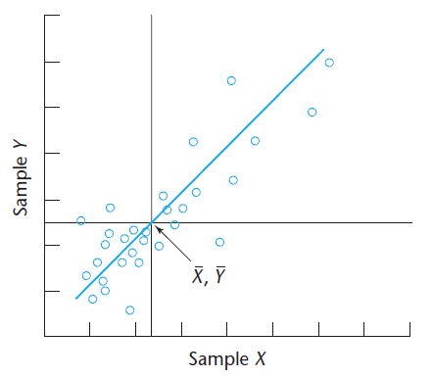
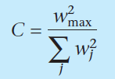
Proficiency testing (PT)
Horwitz equation for relative standard deviation (RSD)
z-score
Collaborative trials (CT)
Youden Plot
Relationship between reproducibility standard deviation (s_{R}) and repeatability standard deviation (s_{r}) plus variation due to inter-laboratory differences (s_{L})
Cochran method for the assessment of homogeneity of variance:
w_{max} is the largest of ranges w_{j} obtained by participating laboratories

Slide 26

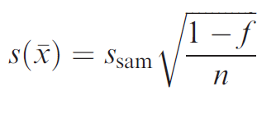





Sampling
overall variance (sampling + method)
uncertainty in x due to systematic sampling, with f representing the ratio between the number of test samples (n) and the total number of items in the population (N)
Relative sampling standard deviation (two types of particles) and relationship between it and the number of particles
relationship between mass of a random grab sample (m) and relative standard deviation for sampling (R)
overall error (e) as a function of sampling and method variances and of the number of samples (n_{samp}) and of replicates for each sample (n_{rep})

